Slide 1


Slide 2


Slide 3






HEWLETT PACKARD

Slide 4

Introduction
An American multinational information technology company headquartered in Palo Alto, California.
Founded in Jan 1,1939,78 years ago.
HP was the world's leading PC manufacturer from 2007 to 2013, after which Lenovo came to rank ahead of HP.
Hewlett-Packard merged with Compaq in 2002 and Agilent technologies in 1999 ,which led to combined revenues of $118.4 billion in 2008 and a Fortune 500 ranking of 9 in 2009.

Slide 5
ENRIQUE LORES
PRESIDENT & CEO OF HP

Slide 6
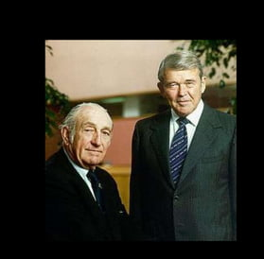


DEVE PACKARD AND BILL HEWLWTT FORMALIZE THEIR PARTNERSHP ON JANUARY 1, 1939
HP IS A TECHNOLOGY COMPANY THAT S ESTABLSHED WORLD WIDE.IT EXPLORE HOW TECHNOLOGY AND SERVICE CAN HELP PEOPLE AND COMPANIES ADDRESS THEIR PROBLEMS AND CHALLENGES,AND REALIZE THEIR POSSIBILITIES,ASPIRATIONS AND DREAMS.
COMPANY PROFILE

Slide 7
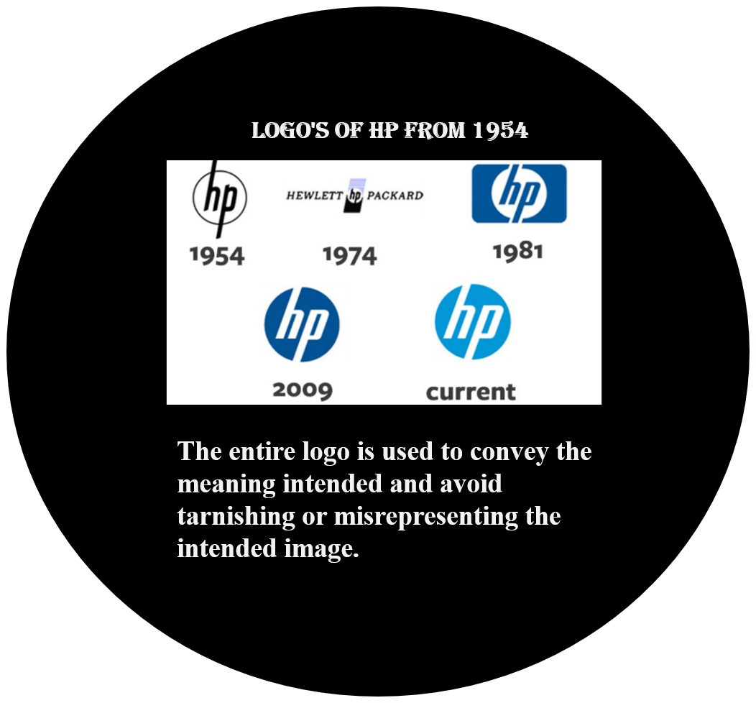

Slide 8
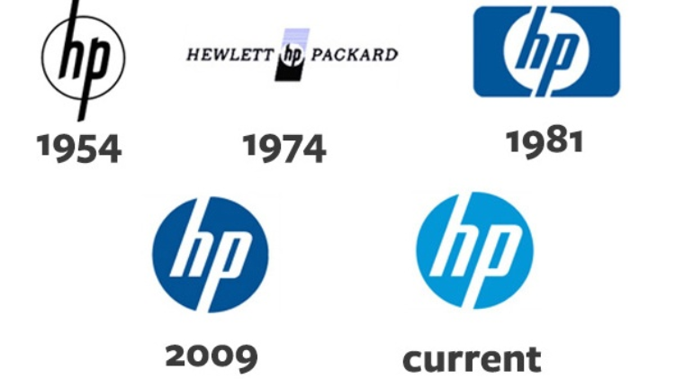

Slide 9
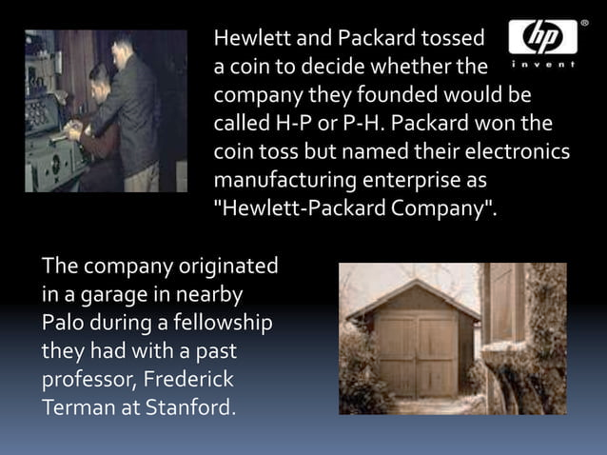
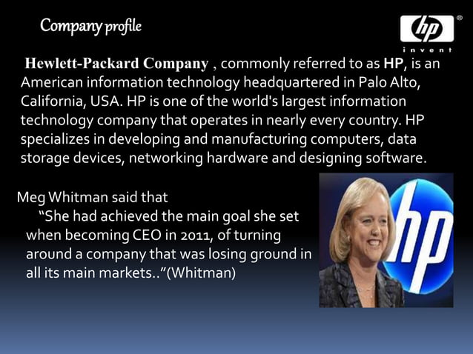

Slide 10
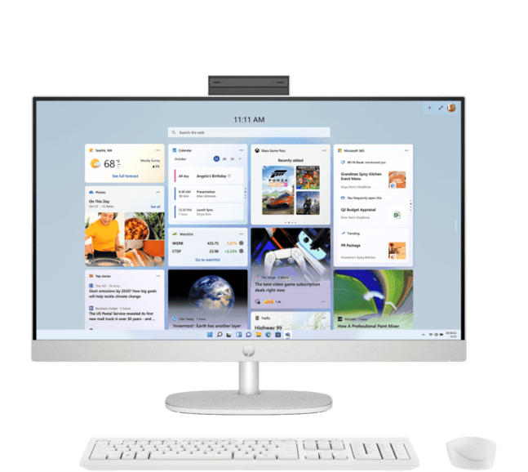
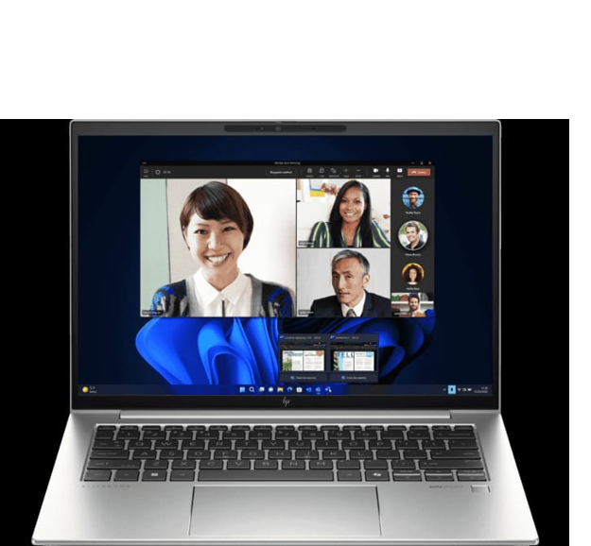
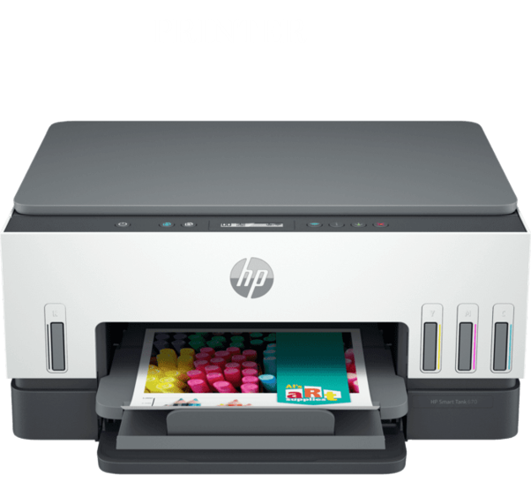

Slide 11
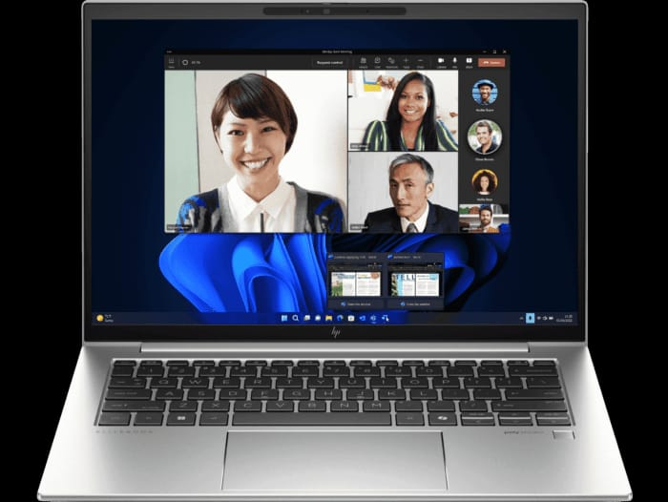
FEATURES
Intel® Core™ Ultra 7 processor
Windows 11 Pro
35.6 cm (14) diagonal, WUXGA display with Intel® Arc™ Graphics
16 GB DDR5-5600 RAM
1 TB SSD Solid State Drive
5MP IR Camera, HP Wolf Security, Spill resistant & backlit keyboard, Fingerprint reader, Military Standard Tested
Fast and efficient wireless LAN
Easy battery management
HP ProBook 440 35.6 cm (14) G11 Business Laptop PC
Affordable devices designed with business in mind; commercial grade features with durable design

Slide 12
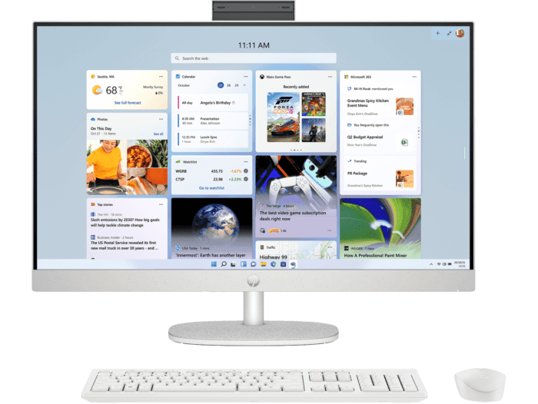
FEATURES
13th Generation Intel® Core™ i3 processor
Windows 11 Home
68.6 cm (27) diagonal FHD display with Intel® UHD Graphics
8 GB DDR4 RAM
512 GB SSD Solid State Drive
HP 510SP White Wireless Keyboard and Mouse Combo, True Vision 1080p FHD IR tiltable privacy camera for better angle, Height Adjustable stand, Screen to body ratio 90:2
DESKTOP
HP 68.6 cm (27) All-in-One Desktop PC 27-cr0345in
Consciously designed thinking about the planet

Slide 13
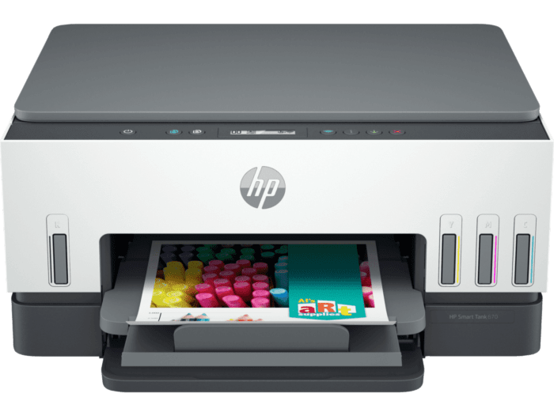
PRINTER
A4 Color Smart Tank All-in-One Printer, Perfect for Home
Print, Copy and Scan
Print speed up to 22 ppm (black) and 21 ppm (color)
USB, Wireless (Wi-Fi®)
Duplex Printing
HP Smart Tank 670 All-in-One Printer
Low Cost - high volume, color printing

Slide 14
DETERMINE THE PLATFORM ON WHICH THE WEBSITE IS DEVELOPED ( USE ONLINE TOOLS TO DENTIFY)

Slide 15

USED TOOLS

Slide 16
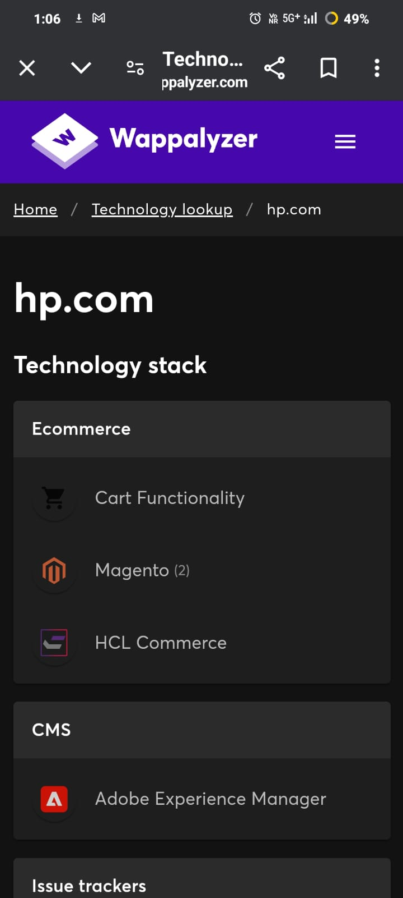
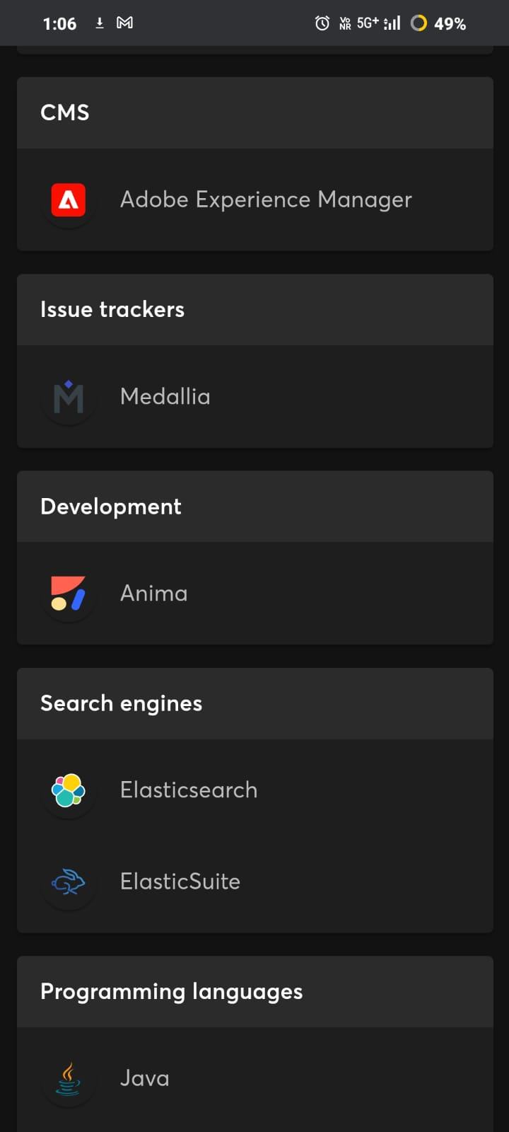
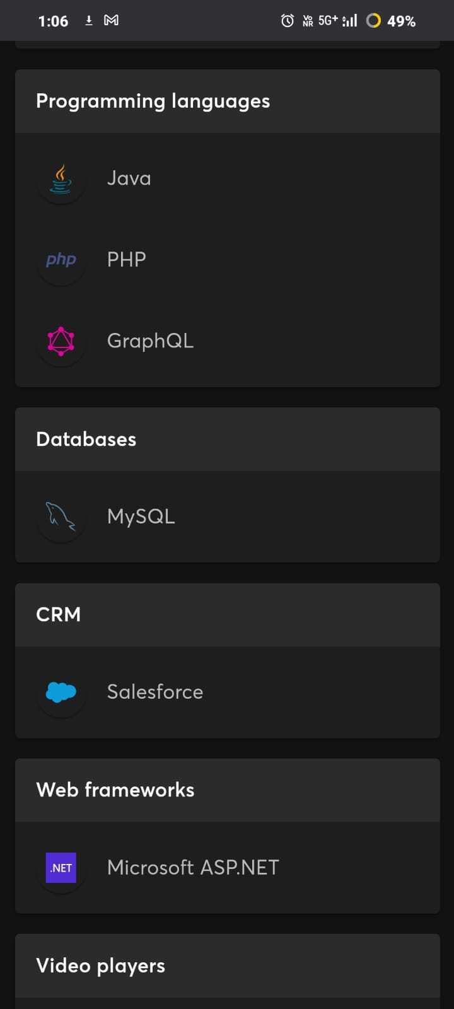

Slide 17
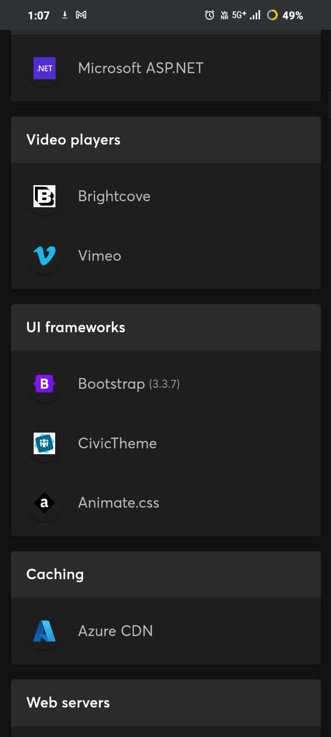
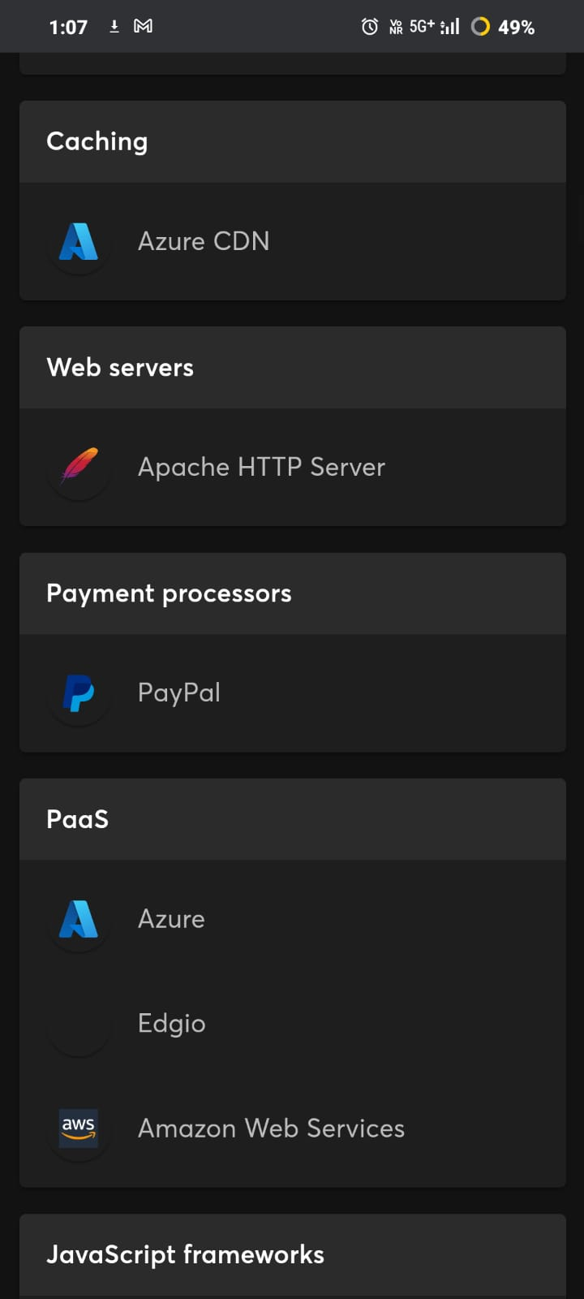
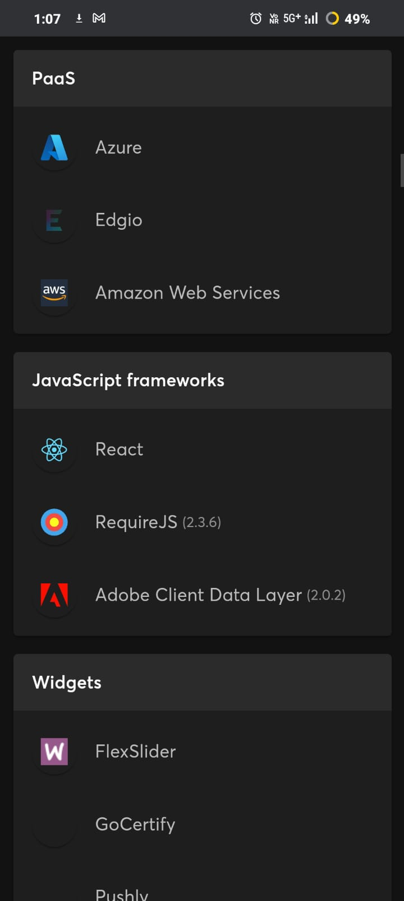

Slide 18
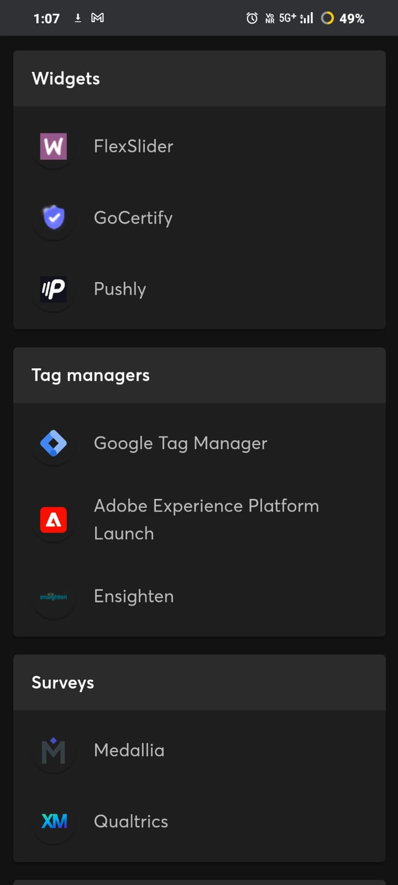
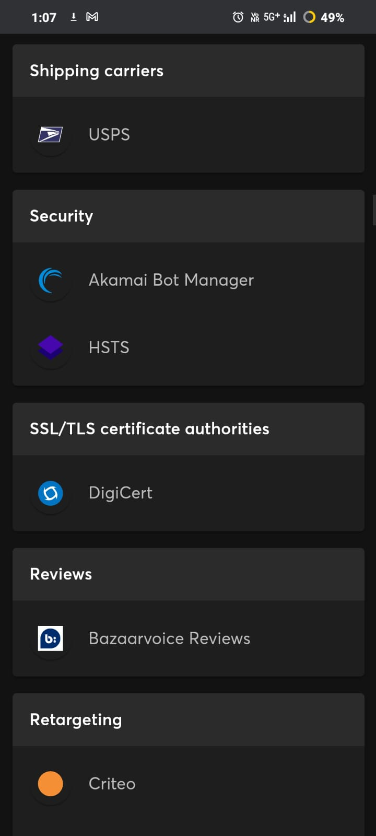
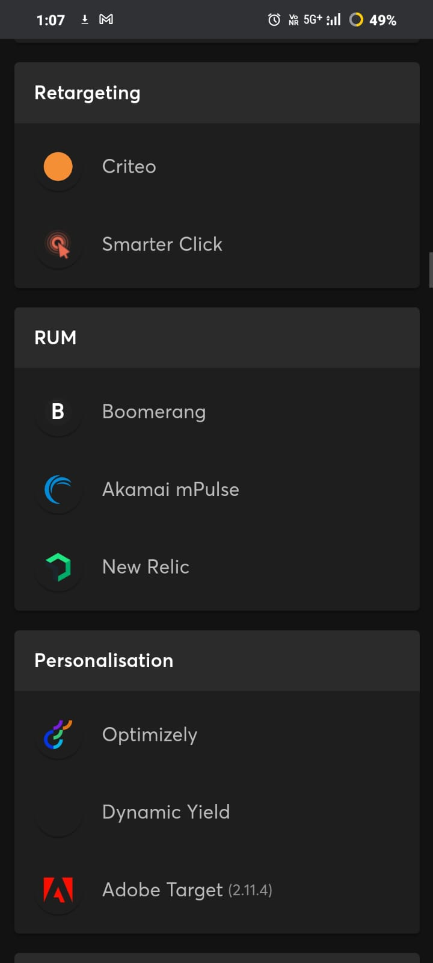

Slide 19

UI FRAMEWORKS
BOOTSTRAP (3.3.7)

Slide 20
4.RESPONSIVE DESIGN TESTING
HP Laptops - Latest Models & Features - Shop HP.com India (PAGESSPEED INSIGHT REPORT) :PageSpeed Insights (WebDAV)
HP Desktop PCs - Windows & Intel - Shop HP.com India (PAGESSPEED INSIGHT REPORT) PageSpeed Insights (web.dev)
Printers for Home & Business - Shop HP.com India (PAGESSPEED INSIGHT REPORT) PageSpeed Insights (web.dev)
HP Printer Cartridge - Ink & Toner for Printers - Shop HP.com India (PAGESSPEED INSIGHT REPORT) PageSpeed Insights (web.dev)
HP Monitors - Price & Features - Shop HP.com India (PAGESSPEED INSIGHT REPORT) PageSpeed Insights (web.dev)

Slide 21
5.Identify the website design mistakes to avoid, such as cluttered layouts and slow loading times
Cluttered Layouts: Avoid overcrowding your website with too much content or design elements. A cluttered layout can overwhelm visitors and make it difficult for them to find the information they're looking for. Keep your design clean and organized, with plenty of white space to help guide the user's eye.
Slow Loading Times: Large images, excessive animations, and bulky code can slow down your website's loading times, leading to a poor user experience. Optimize your images and code, use caching and content delivery networks (CDNs), and minimize the use of large files or scripts to ensure fast loading times.
Poor Navigation: Complex or confusing navigation can make it hard for users to find their way around your website. Keep your navigation simple and intuitive, with clear labels and logical hierarchy. Use breadcrumbs, search bars, and sitemaps to help users easily navigate your site.
Lack of Mobile Optimization: With an increasing number of users accessing websites on mobile devices, it's essential to ensure your site is optimized for mobile. Use responsive design to ensure your site looks and functions well on all devices, and consider mobile-specific features such as touch-friendly buttons and simplified menus.
Inconsistent Design: Inconsistent design elements, such as varying colors, fonts, and styles, can make your website look unprofessional and confusing. Use a consistent design language across your site, with uniform colors, fonts, and layout styles, to create a cohesive and visually appealing user experience.

Slide 22
6.Providing a list of best practices for creating visually appealing and user-friendly website designs
Fast Loading Times: Optimize images, minimize HTTP requests, and use caching to ensure fast loading times and a smooth user experience
Readable Typography: Use readable fonts, appropriate font sizes, and contrast between text and background colors to ensure content is easy to read.
Accessible Design: Ensure your website is accessible to users with disabilities by following accessibility guidelines and providing alternative text for images and other non-text content.
Clear Call-to-Action (CTA): Use clear and prominent CTAs to guide users towards desired actions, such as signing up for a newsletter or making a purchase.
Regular Updates and Maintenance: Keep your website up to date with fresh content, regular maintenance, and security updates to ensure a positive user experience.

Slide 23
Findings
Slow Loading Times
Poor Navigation
Lack of Mobile Optimization
Inconsistent Design
Recommendations
Fast Loading Times
High-Quality Images and Graphics
Readable Typography
Accessible Design
Regular Updates and Maintenance

Slide 24
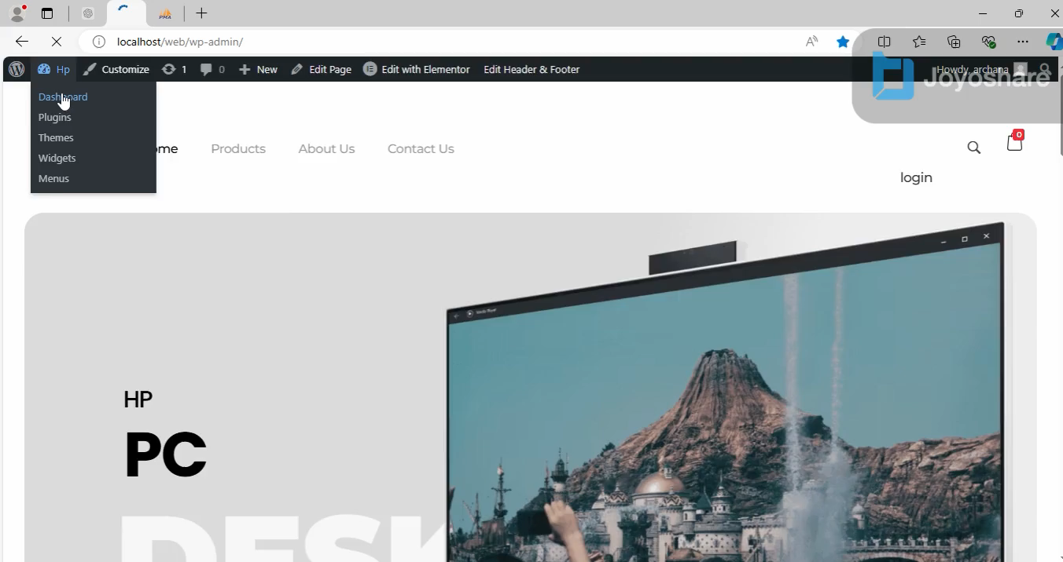
7.LANDING PAGE DESIGN

